Slide 1

332:479 Concepts in VLSI
Design
Lecture 25
Packages and Power
David Harris and Mike Bushnell
Harvey Mudd College and Rutgers University
Spring 2004

Slide 2
Outline
Packaging
Power Distribution
Summary
Material from: CMOS VLSI Design,
by Weste and Harris, Addison-Wesley, 2005

Slide 3
Packages
Package functions
  Electrical connection of signals and power from chip to board
  Little delay or distortion
  Mechanical connection of chip to board
  Removes heat produced on chip
  Protects chip from mechanical damage
  Compatible with thermal expansion
  Inexpensive to manufacture and test

Slide 4
Packaging
Main issues:
  Cost
  Thermal Impedance – how effectively package removes heat from the die
  Lead Inductance
    Ceramic pin grid array package – lowest
    Cheap epoxy plastic – highest

Slide 5
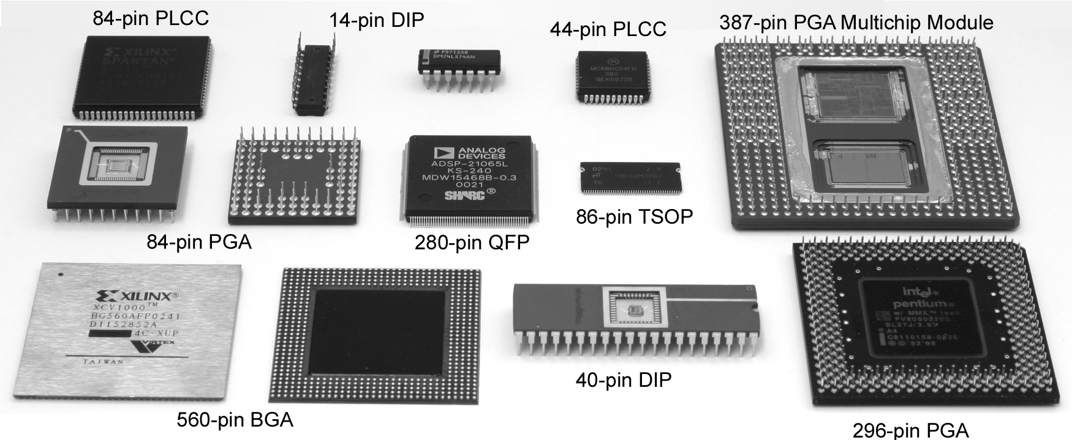
Package Types
Through-hole vs. surface mount

Slide 6
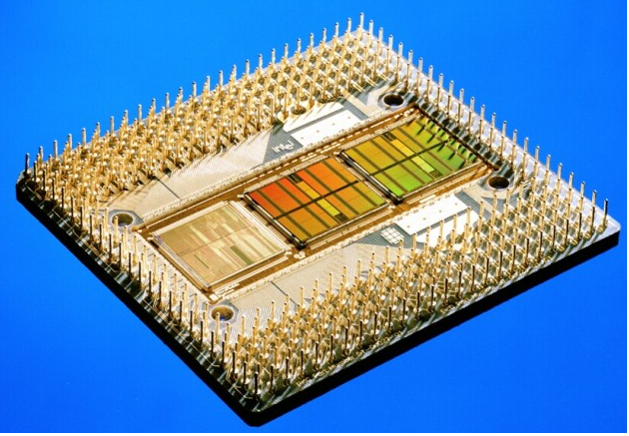
Multi-Chip Modules
Pentium Pro MCM
  Fast connection of CPU to cache
  Expensive, requires known good dice

Slide 7
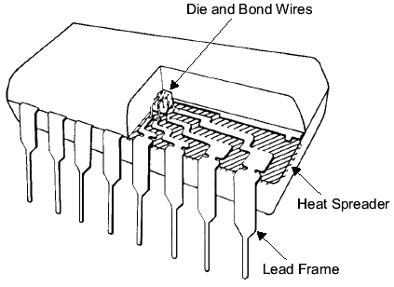
Chip-to-Package Bonding
Traditionally, chip is surrounded by pad frame
  Metal pads on 100 – 200 μm pitch
  Gold bond wires attach pads to package
  Lead frame distributes signals in package
  Metal heat spreader helps with cooling

Slide 8
Advanced Packages
Bond wires contribute parasitic inductance
Fancy packages have many signal, power layers
  Like tiny printed circuit boards
Flip-chip places connections across surface of die rather than around periphery
  Top level metal pads covered with solder balls
  Chip flips upside down
  Carefully aligned to package (done blind!)
  Heated to melt balls
  Also called C4 (Controlled Collapse Chip Connection)

Slide 9
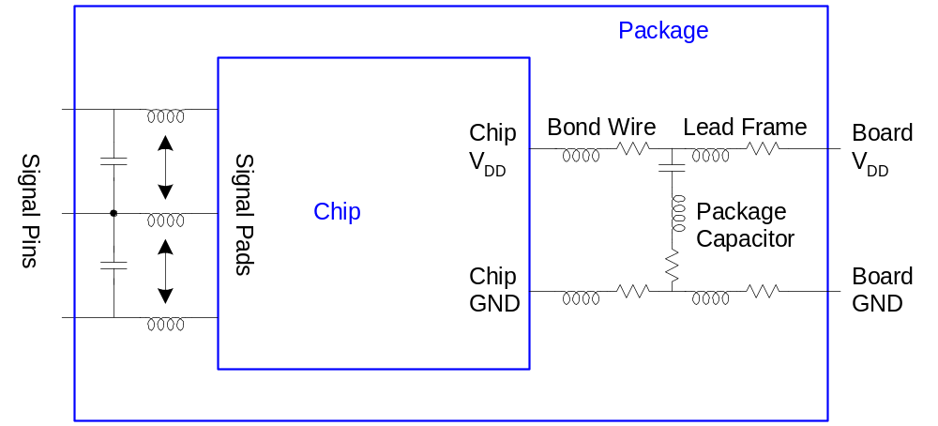
Package Parasitics
Use many V_{DD}, GND in parallel
  Inductance, I_{DD}

Slide 10
Heat Dissipation
60 W light bulb has surface area of 120 cm²
Itanium 2 die dissipates 130 W over 4 cm²
  Chips have enormous power densities
  Cooling is a serious challenge
Package spreads heat to larger surface area
  Heat sinks may increase surface area further
  Fans increase airflow rate over surface area
  Liquid cooling used in extreme cases ($$$)

Slide 11
Thermal Resistance
ΔT = θ_{ja}P
  ΔT: temperature rise on chip
  θ_{ja}: thermal resistance of chip junction to ambient
  P: power dissipation on chip
Thermal resistances combine like resistors
  Series and parallel
θ_{ja} = θ_{jp} + θ_{pa}
  Series combination

Slide 12
Thermal Impedance
Ceramic pin-grid arrays – 15 to 30 ºC/Watt
Plastic Quad Flat Packs – 40 to 50 ºC/Watt
Heat dissipation:
  Finned heat sinks
  Embedded metal slugs
High-cost packages:
  Forced air or liquid cooling through package ducts
  Example: IBM Thermal Conduction Module

Slide 13
Example
Your chip has a heat sink with a thermal resistance to the package of 4.0° C/W.
The resistance from chip to package is 1° C/W.
The system box ambient temperature may reach
55° C.
The chip temperature must not exceed 100° C.
What is the maximum chip power dissipation?

Slide 14
Example
Your chip has a heat sink with a thermal resistance to the package of 4.0° C/W.
The resistance from chip to package is 1° C/W.
The system box ambient temperature may reach
55° C.
The chip temperature must not exceed 100° C.
What is the maximum chip power dissipation?
(100-55 C) / (4 + 1 C/W) = 9 W

Slide 15
Power Distribution
Power Distribution Network functions
  Carry current from pads to transistors on chip
  Maintain stable voltage with low noise
  Provide average and peak power demands
  Provide current return paths for signals
  Avoid electromigration & self-heating wearout
  Consume little chip area and wire
  Easy to lay out

Slide 16
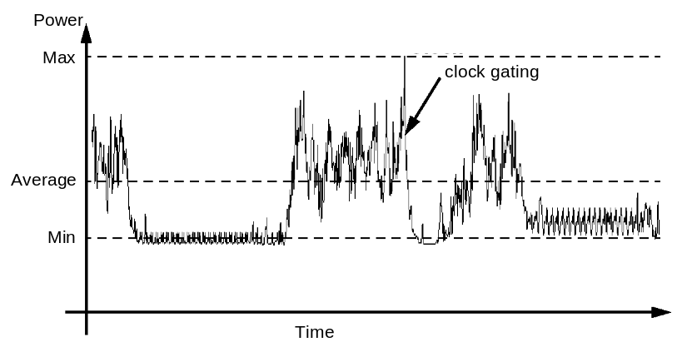
Power Requirements
V_{DD} = V_{DDnominal} – V_{droop}
Want V_{droop} < +/- 10% of V_{DD}
Sources of V_{droop}
  IR drops
  L di/dt noise
I_{DD} changes on many time scales

Slide 17
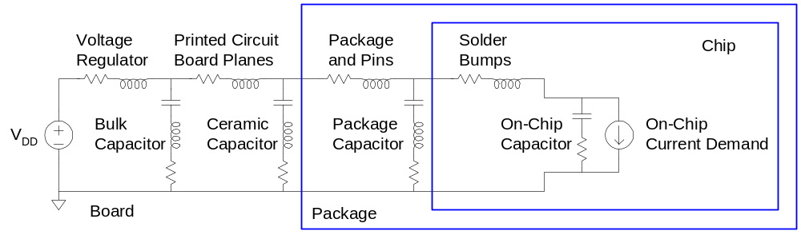
Power System Model
Power comes from regulator on system board
  Board and package add parasitic R and L
  Bypass capacitors help stabilize supply voltage
  But capacitors also have parasitic R and L
Simulate system for time and frequency responses

Slide 18
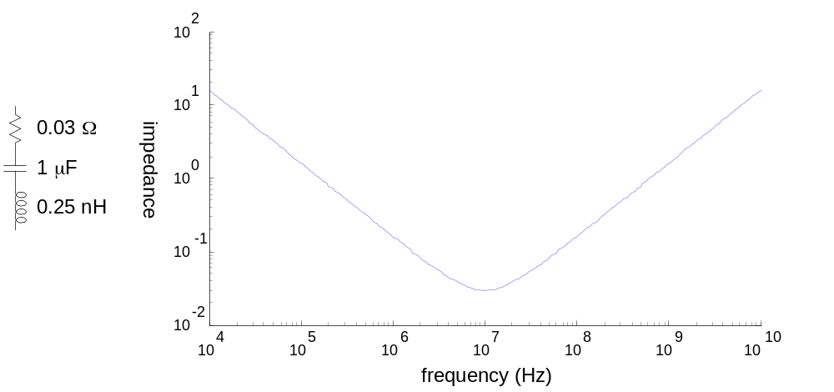
Bypass Capacitors
Need low supply impedance at all frequencies
Ideal capacitors have impedance decreasing with ω
Real capacitors have parasitic R and L
  Leads to resonant frequency of capacitor

Slide 19
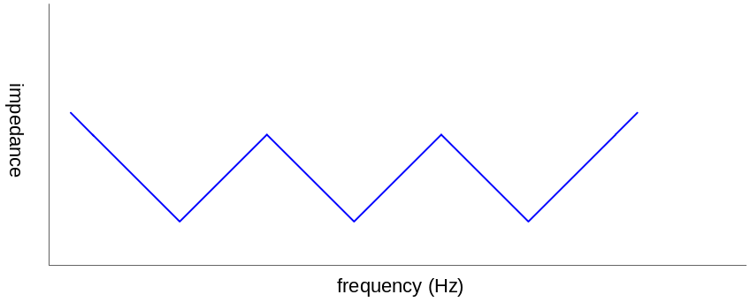
Frequency Response
Use multiple capacitors in parallel
  Large capacitor near regulator has low impedance at low frequencies
  But also has a low self-resonant frequency
  Small capacitors near chip and on chip have low impedance at high frequencies
Choose caps to get low impedance at all frequencies

Slide 20
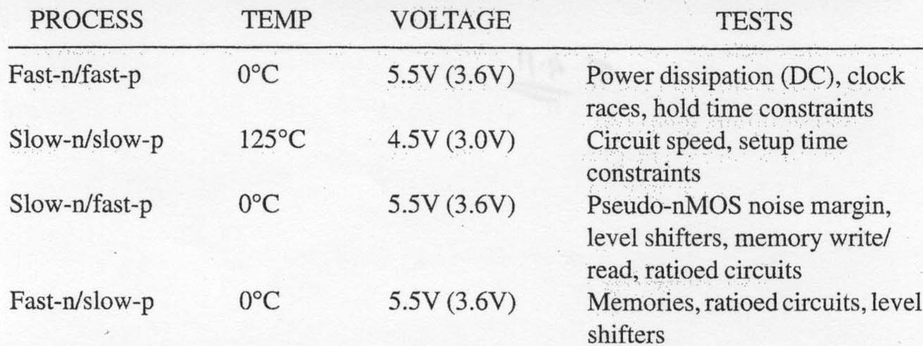
Power & Clock Conductor Sizing
Check for metal migration at worst power corner
Do the following checks:

Slide 21
Summary
Packaging
Power Distribution

